Slide 1
Introduction to Apps for Office Development
Name
Title
Company

Slide 2
Agenda
Introduction to Apps for Office
Developing Apps for Office with Visual Studio 2012
Packaging and Deploying Apps for Office
Designing and Theming Apps for Office

Slide 3
Introduction to Apps for Office

Slide 4
What is the Web Extensibility Framework ?
Web Extensibility Framework (WEF) …
Allows Web page content to render inside Office Application
Allows Web page code to run within a set of constraints
Allows Web page code to interact with Office documents
Allows Web page code to interact with Exchange items
WEF is the development platform used to build Apps for Office
Apps for Office provide basis for a component architecture
Apps for Office provide foundation for an Office Store and App Catalogs
Apps for Office can be deployed in private networks
Notes:
So in the past, developing plug-ins or extensions to Office required very specific skillset and tools. These customization sometimes made it hard for organizations to upgrade to the latest and greatest version of Office.
In contrast, the new Apps for Office development model caters to the army of web developers, perhaps the biggest developer community in the world. It allows them to develop Apps for Office using familiar technologies such as HTML5, CSS, and JavaScript and run them from virtually any web server. In fact, installing an App for Office doesn’t really install any code, it just tells Office what type of App it is, where the app lives, and how the app wants to interact.
The Web Extensibility Framework (WEF) is the new development platform used to Apps for Office. This platform allows web page content to render inside Office Applications with a set of constraints and interact with Office content such as Word documents, Excel workbooks, and Exchange messages and appointments.
Apps for Office enable a whole new approach to app distribution through directories like the public Office Store and Corporate Apps Catalogs. The Office Store is a public marketplace for apps that will enabled developers sell apps to the massed. Corporate App Catalogs will enable organizations to provide a private app directory for organizations.

Slide 5
What is an App for Office?
A Web page loaded inside an Office Application
Embedded inline or as task pane within documents, mails or appointments.
Works in both Office Applications and Office Web Applications
Allow Office applications to leverage Web technologies
HTML 5 and CSS for rendering user interface
JavaScript and jQuery to add behavior
Calls to REST APIs to retrieve and update data from across network
Notes:
An App for Office is delivered through web page loaded inside an Office Application. These apps can take on many appearances, such as inside the document in a task pane or even within an Outlook message.
The architecture on Apps for Office has been designed to work in both the Office rich-client and the Office Web Applications.
As mentioned before, WEF and Apps for Office enable Office to be extended by leveraging familiar Web technologies such as HTML5 and CSS for rendering user interface as well as JavaScript and jQuery to add behavior.
When you write the JavaScript code in an App for Office, you can call REST APIs such as those added to SharePoint 2013 to retrieve and update data from across network.

Slide 6
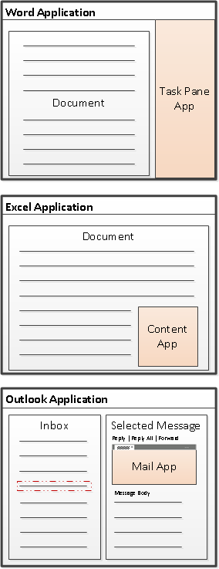
Types of Apps for Office
Task Pane App for Office (Document-centric)
Assists user working with one or more documents
Works in Word, Excel and Project
Content App for Office (Document-centric)
Adds embedded content/functionality into document
Only used in Excel Application and Excel Web Application
Mail App for Office (Mailbox-centric)
Used in Outlook Application and Outlook Web App (OWA)
Extends Outlook items with custom UI and behaviors
Outlook items can be messages and events
Mail Apps require Exchange 2013
Notes:
There are three basic types (i.e. shapes) for Apps for Office.
Task Pane Apps are document-centric and are designed to assist user working with documents.
Task pane apps can be used in Word, Excel and Project.
An example of task pane app might be for searching the Internet on links related to text selected in a document
Content Apps are document centric and are designed to add embedded content and functionality directly into a document.
Content apps are used exclusively with Excel 2013 so the associated document will always be an Excel workbook.
An example might be a rich data visual that leverages a range of cells in an Excel Workbook
Mail Apps are designed to extend Outlook items such as messages and appointments with custom UI and behaviors.
Being mail-centric, they are used in in the Outlook rich-client as well as in the Outlook Web App (OWA).
Mail apps are often called contextual apps since they triggered or activated based on rules configured in the app
An example might be to activate a package tracking app when a message contains string that follows the known pattern of a tracking number
It is important to note that mail apps require Exchange 2013…Exchange 2013 provides new capability to store the manifests for mail apps

Slide 7




App for Office Matrix
 | Office Application | Office Web Application
Task Pane Apps
Content Apps
Mail Apps
Notes:
One of the great things about Apps for Office is the ability for many of them to run both in the Office rich-client applications and the office web applications
Here you can see that Excel and Outlook can delivery their apps in both a rich-client and browser client

Slide 8





Anatomy of an App for Office
Each App for Office is based on XML-based manifest
Manifest points to a Web page
Manifest defines the type of the App for Office
Manifest defines which Office applications it supports
Manifest defines required capabilities
App for Office
Catalog Server
Web Server
App for Office
App for Office
Manifest
<XML>
Web
Page
HTML+JS
Notes:
The anatomy of an App for Office is made up of two parts…the web content that lives on an web server, and an XML-based manifest which contains information about the app. The manifest includes information such as
The url of starting web page for the app
The type of app
Which Office applications the app supports
And the permissions that the app needs in order to run and complete its work (ex: read vs read/write)…you have to request the capabilities your apps needs in this manifest

Slide 9
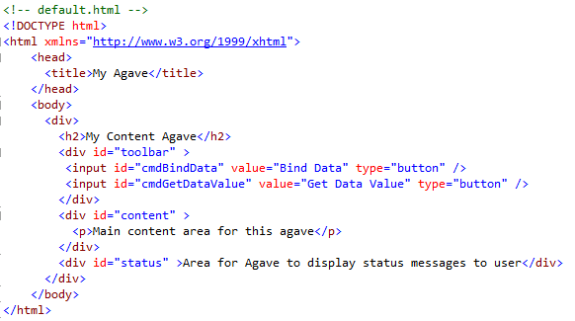
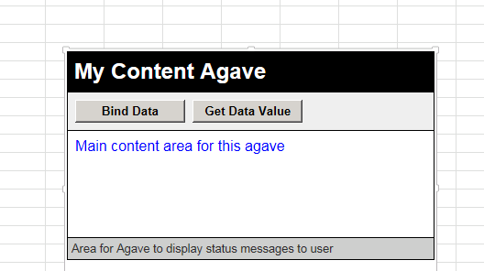
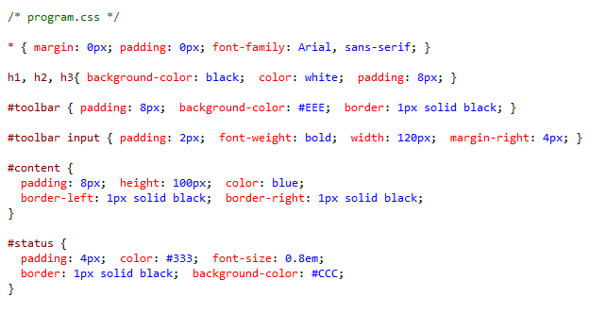
Creating the UI for an App for Office
My Content App
Notes:
This slides shows a simple content app embedded in an Excel worksheet
Again, the user interface of this app has been created using an HTML page layout as shown in the code on top and a CSS file with style rules seen on the bottom

Slide 10
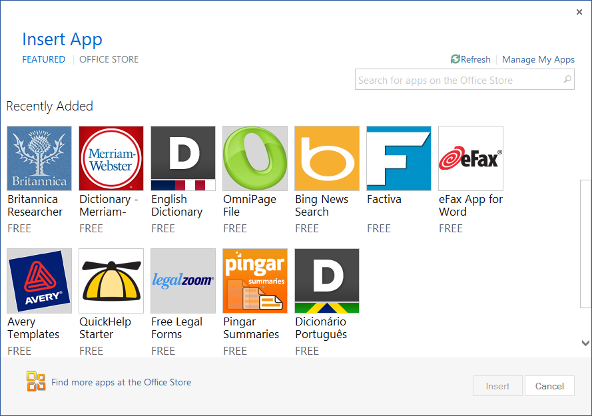
Adding a App for Office using the Insertion UI
Apps for Office insertion UI located in Ribbon inside Insert Tab
Dialog allows you to add and start App for Office app
Notes:
When it comes time for a user to add an app for Office, Office 2013 provides users with an insertion UI to discover and insert apps.
In Word and Excel, this done through the Ribbon inside the Insert Tab.
This tab contains a new Apps drop-down menu that shows recently selected apps AND allows a user to "Select All“ to look in various app directories such as a corporate catalog or the public Office Store
Once you find an app you want to use, you can insert the app into the current document. When you save the current document it will save the app with the document.

Slide 11
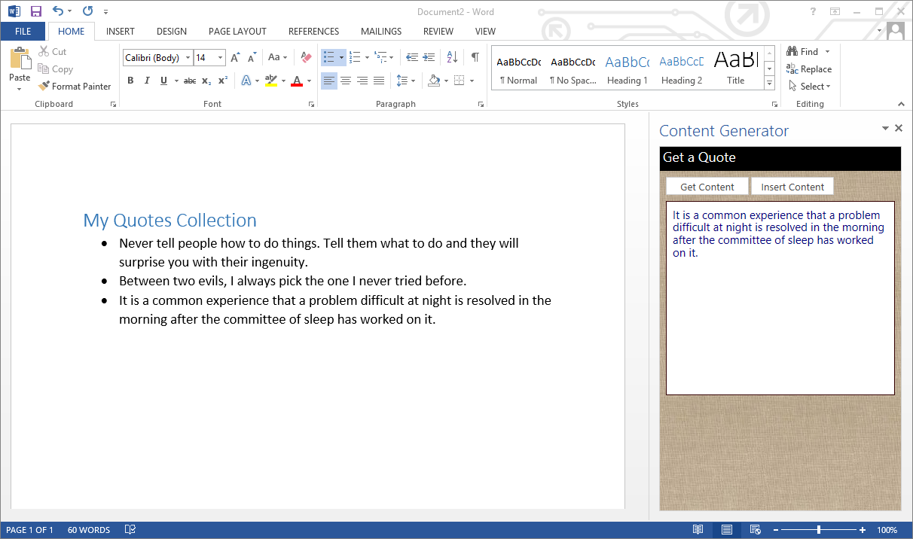
Using a Task Pane App for Office in Word
Notes:
Here is an example of a task pane app…you can see the task pane app on the right side of the screen. The task pane defaults to about 320px wide, but the user can resize the pane. A task pane app can be designed to read and write content to and from the current document.
Task pane apps are often built to react to events such as a user selecting content within the document or task pane.
The Task Pane App can then provide value by allowing the user to run a command such as Translate which will send the text to a service on the Internet such as the Bing translation service. Once the text has been translated, the app can then allow the user to insert the translated text back into the document.
A Task Pane App assists the user in building a document. However, the task pane app is not part of the document itself.

Slide 12
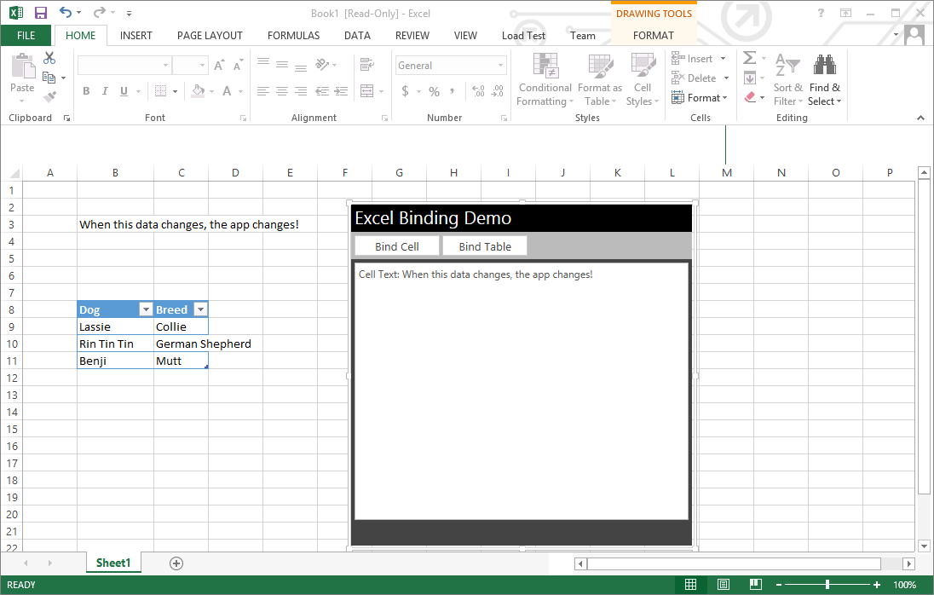
Adding a Content App for Office in Excel
Notes:
A content app is different than a task pane app because it is embedded in the document and this becomes part of the document.
A content app requests a default height and width, but can be resized by the user
The content app can read and write content from the cells in the hosting Excel worksheet and becomes a part of the viewable (and printable) worksheet itself.
Remember, content apps can only be developed for Excel

Slide 13
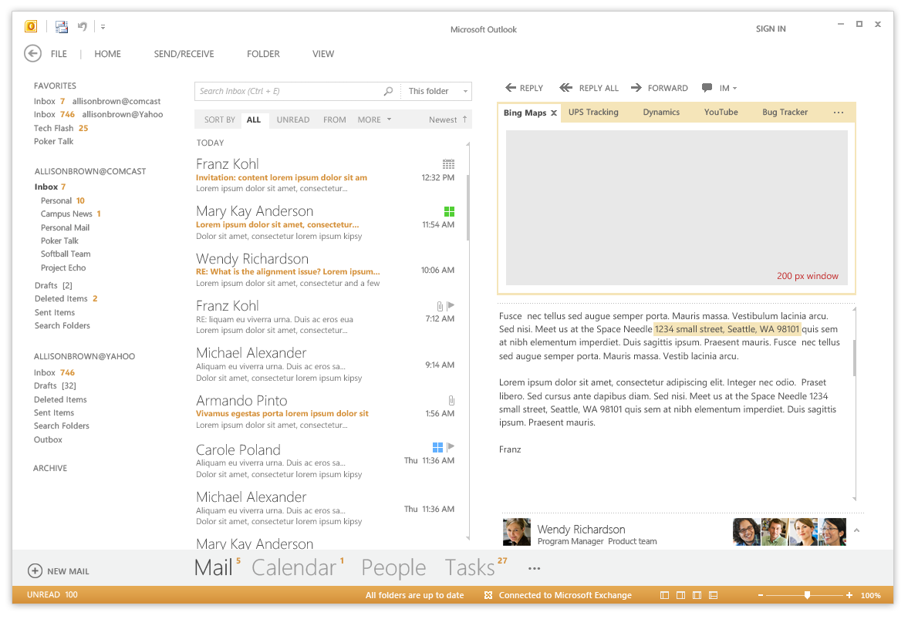
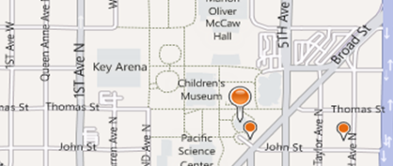
Mail App for Outlook
Notes:
Mail Apps are specifically designed to target Outlook and Outlook Web Access (OWA).
These contextual apps are activated based on rules configured in the app such as a specific sender, text in the title, or regular expression match in the body
As cool as mail apps are, we didn’t want them dominating real estate on an outlook screen…so instead mail apps are always collapsed until a user launches them.
What happens is, once a mail app is activate for a particular mail item, it’s name will appear in the mail app title bar as shown in the screenshot above
However, the mail app won’t actually launch until the user clicks on the mail app title

Slide 14
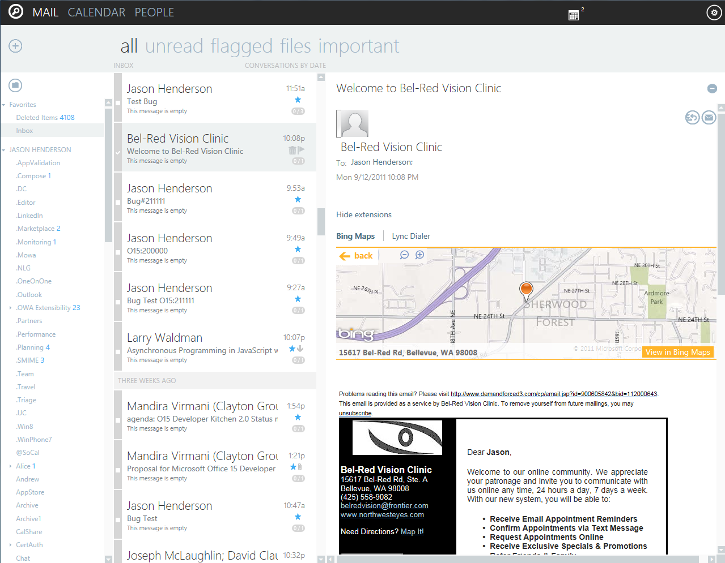
Mail App for Outlook in Outlook Web App (OWA)
Notes:
Again, one of the cool things about these mail apps is that they work in both the Outlook rich-client AND the Outlook Web App. The screen here shows a bing maps mail app being displayed in OWA based on the detection of an address.
This is a key benefit to developing mail apps…that they do not need to be rewritten for a browser-based client
In fact…NEXT SLIDE

Slide 15
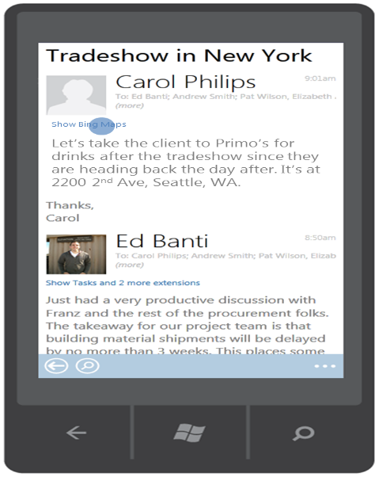
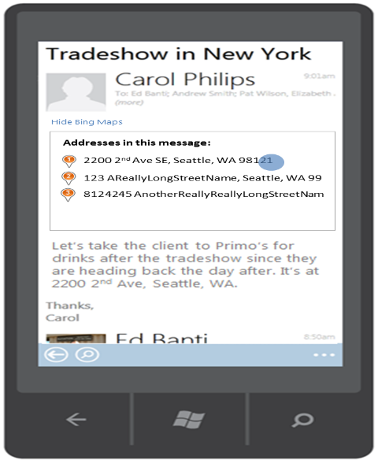
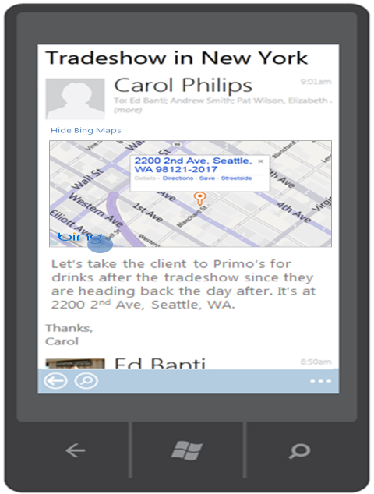
Mail App for Office in OWA for Mobile
Notes:
Mail apps can also be designed to target mobile devices which run OWA such as Windows Phone 7.
When developing a mail app that you plan to run on mobile devices, you should design and test the HTML layout to make sure the user experience is a good one when running on a device with a much smaller form factor…for example, a shorter width

Slide 16
Developing Apps for Office with Visual Studio 2012

Slide 17
Visual Studio Experience
Create new App for Office project
Create/design user interface for Web page
Enhance Web page with CSS and JavaScript
Set project properties in manifest
Run!
Notes:
The process for developing Apps for Office is very similar to developing other types of software in Visual Studio.
First, you will create a new project using a new “App for Office 2013” project template in Visual Studio 2012.
Next, you will create the app user interface using HTML5 and CSS.
Once all the display elements have been created, you can add javascript to give the app some sort of behavior.
Finally, you will update the XML file which serves as the app manifest.
At this point, the app will be ready to debug and you can simply press the {F5} key to test and debug the app.

Slide 18
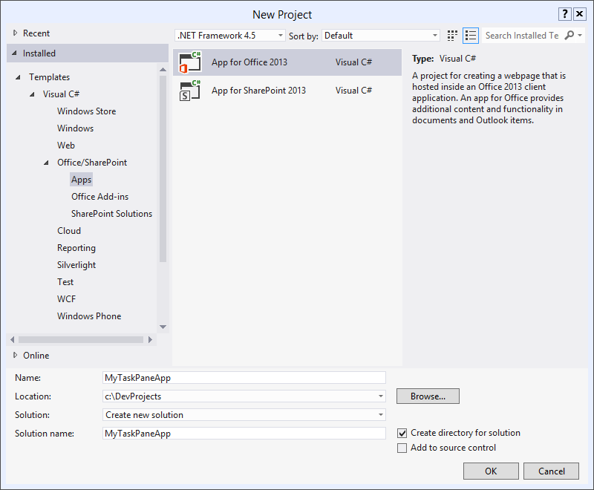
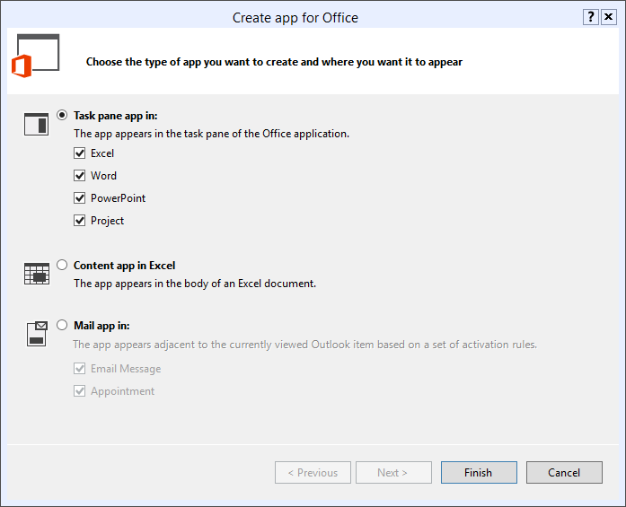
Create New App for Office Project
Create new project based on App for Office 2013 project template
Dialog appears and prompts you for specifics about the app
Notes:
What you will see is that Visual Studio has a new project template for “App for Office 2013”.
Selecting this template will walk you through a wizard for selecting the type of app (task pane, content, or mail) and in the case of task pane apps, ask you to specify the supported Office applications for the app
The solution it creates gives you a starter assets such as a web page, some basic styles/scripts, and app manifest.
Let’s look at the solution structure in more detail…(NEXT SLIDE)

Slide 19
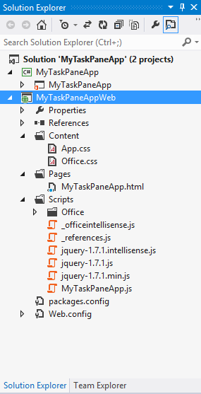
App for Office Project Structure
App for Office solution has two projects
Top project contains app manifest
Bottom project for remote web
Remote Web Project is ASP.NET Website
Contains HTML, CSS and JavaScript source files
Integration with jQuery library already included
Notes:
The slide shows the initial structure of a task pane app created with the Visual Studio 2012
You can see from the solution explorer that the solution is created with two project…one for the manifest and one for the web application
This should make sense since all Apps for Office have two components…the manifest that Office/Exchange is aware of and the web application, which lives on some web server
You can see that the web project includes things like a default HTML page, some css, and scripts such as the WEF scripts and jquery.
The project also includes an empty css and js file for styles and scripts specific to the app.
You will notice that the template creates basic html pages, which makes sense since the APIs to interact with Office are javascript. However, a developer could easily leverage this client-side API in conjunction with a server-side web technology such as ASP.NET, MVC, or even something like PHP…remember the code in Apps for Office runs on any web server…Office just needs to know the app entry point, which is handled in the app manifest

Slide 20
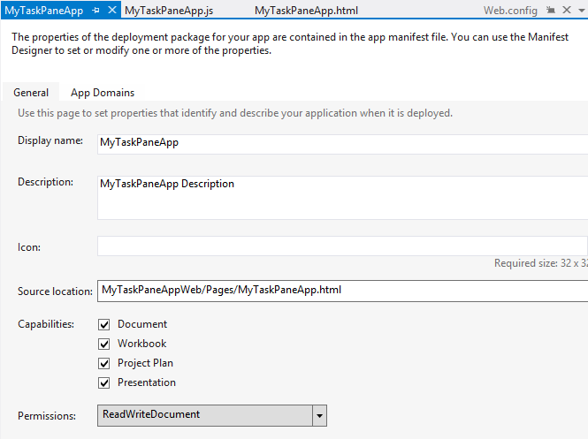
App Manifest Designer
Notes:
This slide shows the Visual Studio designer for an app manifest, which is an xml file behind the scenes
This particular manifest happens to be for a task pane app. Each of the different app types will have a manifest that looks a little different based on the setting for that app type.
Notice the source location that specifies the app entry point web page. This is currently a relative path for debugging, but would change to an absolute url if we were adding it to a the Office Store

Slide 21
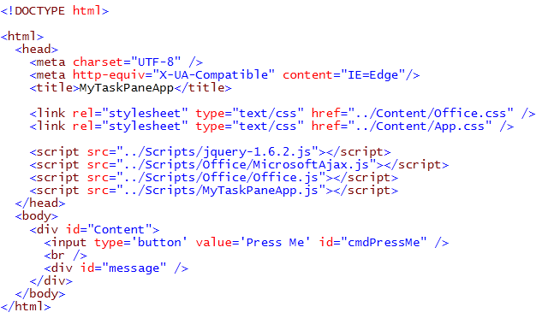
Create the HTML for a Web Page
Notes:
Each app has a source location which points to a entry point Web page somewhere on the Internet.
Here is an example of a simple Web page that is used to load a task pane app.
Notice that this page must link to any required CSS files and JavaScript that it will leverage.
The project template will add many of these links automatically like Office styles, jQuery, and ASP.NET AJAX.
However, any new references would need to be added here.

Slide 22
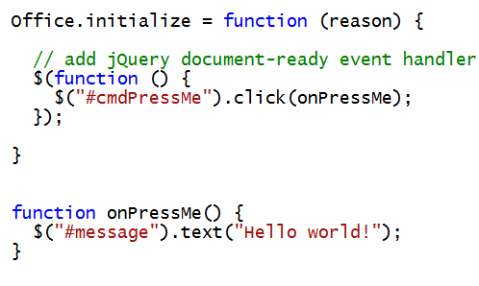
Write The “Hello Word” JavaScript
Notes:
With our display elements in place, it is time to wire up some behaviors
JavaScript is the language that is used for these apps to interact with Office Applications.
The JavaScript you write will typically take advantage of the various JavaScript APIs supplied in Office.js and other JavaScript library files for specific Office applications such as Word, Excel and Outlook.
In addition to the Office JavaScript APIs, the JavaScript code you write for an app for Office can also take advantage of the ASP.NET AJAX library as well as jQuery.
The Office JavaScript API provides a top-level Office object which provides an initialize function.
By overriding this function as shown in the sample, you can write code that will automatically execute as the end of the initialization process when an app is started.
A common approach is to register a jQuery document ready event handler inside this function.

Slide 23
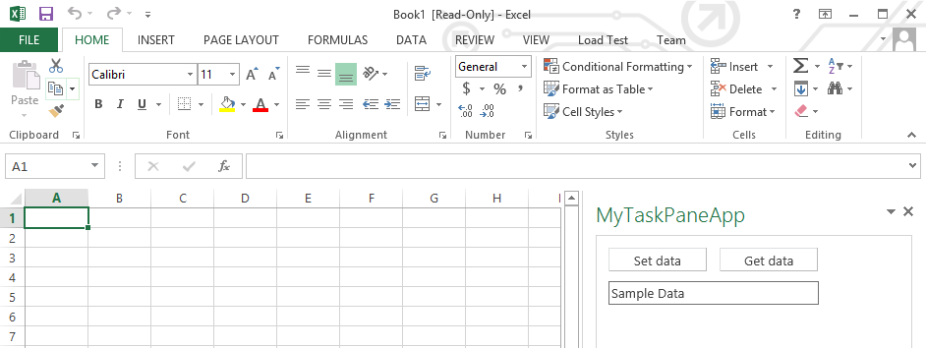
Test/Debug the Apps for Office using {F5}
Notes:
When you press the {F5} with a Visual Studio 2012 project for an task pane app or a content app, Visual Studio automatically adds a registry entry to allow Office applications such as Word and Excel to discover the app which makes it possible to add it to a document.

Slide 24
Developing a Task Pane App for Office with Visual Studio 2012
demo

Slide 25
Packaging and Deploying Apps for Office

Slide 26
Distribution of Apps for Office
Mommy, where do Apps for Office come from?
App for Office distribution/deployment model based on App Catalogs
App for Office is published by uploading its manifest to an App Catalog
User inspect App Catalog with Office Applications UI to discover Apps
User can create and start an App for Office found in App Catalog
There are several different types of Catalogs
Office Store
SharePoint App Catalog
File Share App Catalog
Exchange App Catalog
Notes:
So Apps for Office are cool…great, so how we distribute them?
The distribution and deployment model these apps is based on App Catalogs, which are public and private repositories which contain app manifests.
An App for Office is published by uploading its manifest into one of these App Catalog.
Office users can have their machines to point to one or more catalogs and to discover which apps are available and look interesting.
There are several different types of Catalogs
The Office Store which is a Microsoft-hosted catalog publically available to all users on the Internet.
A SharePoint App Catalog is a SharePoint site collection which makes apps available to users in a private network.
A File Share App Catalog is simply a Windows file share which has been configured to contain app manifests.
The Exchange App Catalog is the place where all mail app manifest must reside before their associated mail apps can be used.
Let’s dig a little deeper into each of these

Slide 27
The Office Store
The Office Store functions as public marketplace
Provides catalog of Apps for Office to consumers and general public
Office Store managed by Office.com
Consumer identity on Office.com established by Windows Live ID
Apps for Office tied to user by using identity established by Live ID logon
It's easy to publish a App for Office to the Office Store
You just need to publish the App for Office manifest
The manifest points to a Web page anywhere on the Internet
Microsoft controls vetting process to ensure integrity of Apps in Office Store
Notes:
The Office Store functions as public marketplace in that it provides a catalog of Apps for Office to consumers and the general public.
The Office Store is managed by the Office.com team at Microsoft and populated with apps that have been published by 3rd party developers
Consumers are identified on Office.com by either a personal LiveID account or an Organizational LiveID account. So either way the consumer of apps from the Office Store must be logged onto LiveID to be find, rate, and install apps from the Office store.
For a developer, it's relatively easy to publish a App for Office to the Office Store. When you are finished with your development and testing, you just need to publish the app manifest to the Office store. The manifest points to a Web page anywhere on the Internet that contains the implementation.
Microsoft controls process for validating apps published to the Office store to maintain integrity and to ensure all apps have been created consistent with the Microsoft guidelines which are published online for developers.

Slide 28
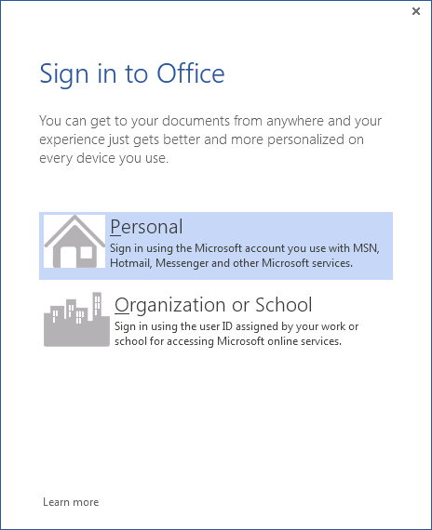
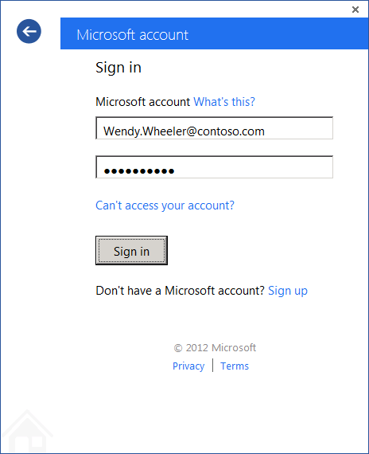
Office Store Login and User Identity
Downloading and using apps for Office Store requires login
Login identity can be per-user or organization
User and organization accounts authenticated by Windows Live ID
Create or use existing Windows Live account to get started
Notes:
Here is an example of the login required to use the Office Store…notice the login identity can be per-user or organization

Slide 29
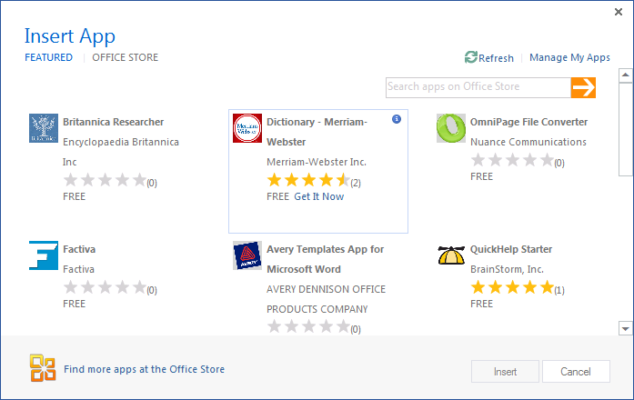
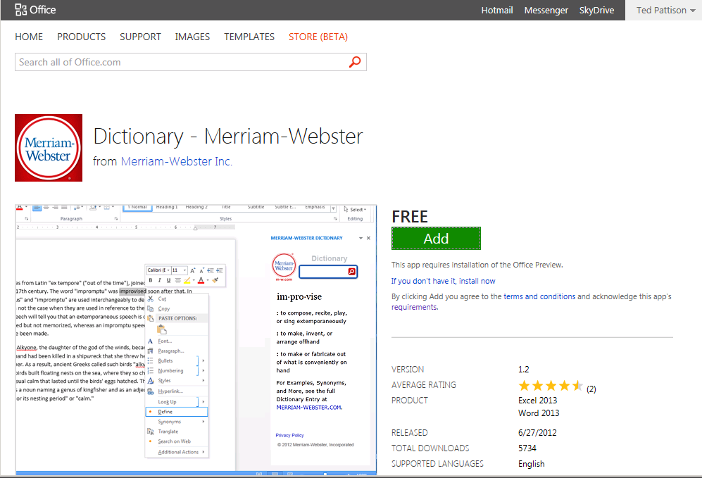
The Office Store – Adding an App To Your Account
Notes:
And here are a few screenshots of the Office Store, in this case, a list of featured apps and an app detail page.
You will notice a number of different app publishers in the Office Store. Althout it is publish marketplace, remember that Microsoft vets all apps before they can be published to ensure they meet the required guidelines.
Users can be confident that apps obtained from the Office Store meet a certain level with respect to quality and standard functionality.

Slide 30
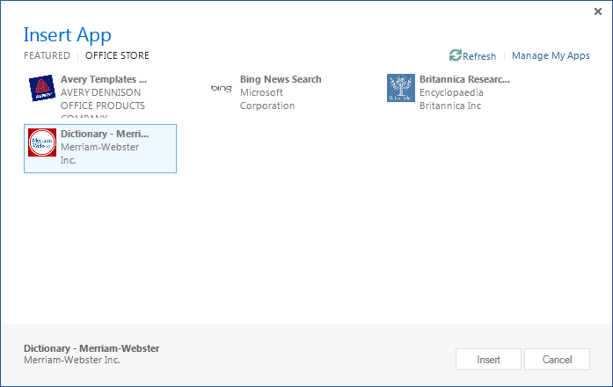
Inserting and Starting An App from the Office Store
Steps after adding an app from the Office Store
Click Office Store Tab
Click Refresh Link
Locate and Select App
Click Insert Button
1
2
3
4
Notes:
Once you have added an App from the Office Store, you must go through a few extra steps before you can use it in an Office application such as Microsoft Word or Microsoft Excel.
Click on the Office Store tab of the App Dialog in Office
Click Refresh
Locate the added app
Click the insert button

Slide 31
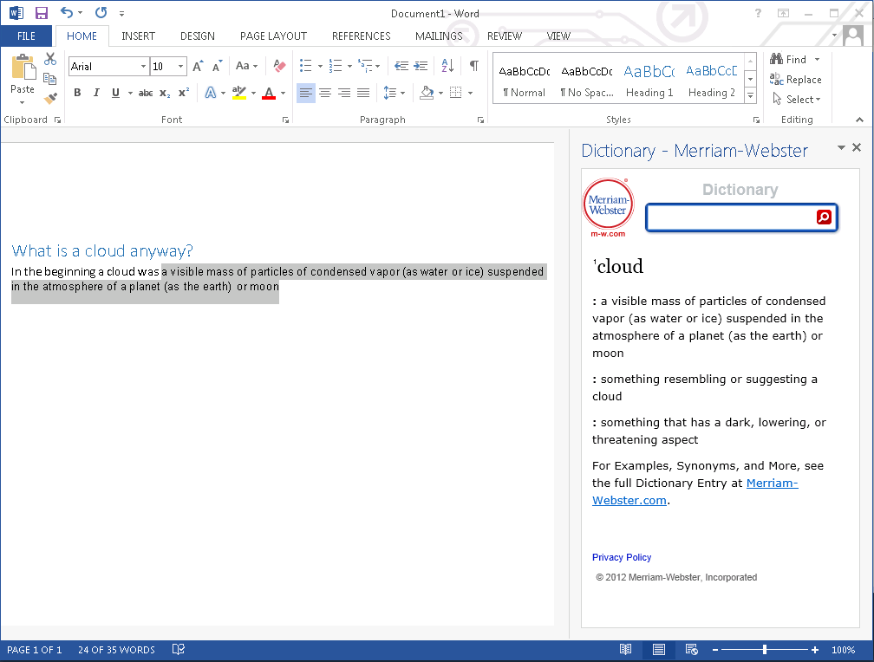
Using an App from the Office Store
Notes:
Here is screenshot showing the app after it has been inserted in a Word document.
Different apps provide different user experiences.
This is a free task pane app from the Office Store which allows users to leverage the Marriam-Webster online dictionary lookup service to look up words and terms right from within Microsoft Word.

Slide 32
Enterprise Management of Apps for Office
Deploy centrally
App deployment based on using one or more SharePoint App Catalogs
You can deploy pre-approved apps and/or apps developed in-house
Control and Flexibility
Tenant administrator can control access to Office Store
Workflows available to assist with purchasing, licensing and deployment
Monitoring and Governance
Centralized telemetry and analytics
Control app availability
Notes:
If you want to create an App for Office that is intended to be private for your organization on your corporate network, then you must be able to deploy them centrally.
The most flexible approach for this is to publish them to one or more Apps Catalogs in a SharePoint 2013 farm. This will enable you to deploy pre-approved apps obtained from third party vendors and/or deploy apps developed in-house.
In Office 365, the App Catalog is scoped at the tenancy level. In an on-premise farm, an App Catalog is scoped at the Web Application level.
Whoever has administrative privileges can also control access to Office Store.
In addition, workflows are available to assist administrators and purchasing agents with purchasing, licensing and deployment of apps.
The infrastructure for apps also assists with monitoring and governance.
For instance, there is centralized support that provides telemetry and analytics.
It is also possible to control app availability through the App Catalog and to disable an app through a central kill switch.

Slide 33
App for Office Deployment
Deployment is similar to standard web apps
Exception – App manifests are served from App Catalogs
IT admins can designate trusted App Catalogs via GPO
Deploy App files (CSS, HTML, and JavaScript) to any web server
Manifests for Mail Apps are served from App Catalog in Exchange 2013
Choosing An App Catalog
SharePoint App Catalog is preferred because it offers several advantages
File Share App Catalog deployment is a simpler, less-powerful option
Notes:
When it is time to deploy an app, the actual deployment is similar to standard web site because you must make all the app web artifacts available on a web server.
However, you must also publish the manifest to make the app discoverable for installation…this occurs in the App Catalog
So remember…web artifacts…any web server…app manifest…app catalog.
Catalogs are made available by IT admins designating the catalog location as trusted in machines registries through group policy
The exception to this model is Mail Apps, which are instead uploaded to an Exchange 2013 App Catalog.
I mentioned that a SharePoint-hosted App Catalogs provide the most flexibility and governance for corporate app publishing. Another option is to leverage a file share app catalog, which is basically a simple file share containing app manifests. Client machines just need registry entries pointing to this share, which can again be achieved through Group Policy

Slide 34
SharePoint App Catalog
Designed for private corporate networks
Provides users with catalog of pre-screened and pre-approved apps
Often used to deploy apps developed in-house of by 3rd party ISV
Supports document-based apps (i.e. Task pane apps and Content apps)
SharePoint App Catalog hosted using Site Collection
Actual catalog is document library containing app manifests
Administrator can configure app for Office security settings
Notes:
Just a little bit more on the SharePoint App Catalogs...they are implemented using as site collection created from a new “App Catalog” site template. The app Catalog is designed for Office 365 and for private corporate networks in that it is available to only to users who have been granted access.
This corporate catalog approach provides users with pre-screened and pre-approved apps. An App Catalog can be used to deploy apps developed in-house or by 3rd party ISVs. Note that the App Catalog in SharePoint supports document-based apps (i.e. Task pane apps and Content apps).
Since the SharePoint App Catalog hosted using a SharePoint 2013 site collection. The actual catalog is simply a document library where app manifests are uploaded. This allows an administrator easily configure app security for who can see and install the apps.

Slide 35




SharePoint as an App for Office Catalog
IT admin controlled access via GPO
SharePoint
On or off premise
Upload manifest to document library
App catalog document library
End user
SP admin
Manifest
App for Office
Developer
Manifest
(XML)
App for Office Insertion UI
App Files
(HTML, JS, CSS, etc.)
WEF Runtime
IT admin
App Host
App manifest
App Files
App Files
Deploy files to a server using standard web deployment method
Any web server on intranet or internet. This could also be SharePoint
Notes:
This picture shows the pieces that are involved in app for Office deployment. Note that the app manifest must be uploaded to a SharePoint app catalog.
While the app manifest needs to be uploaded to the SharePoint App Catalog, the app web artifacts just need to be deployed on a Web server of any type. However, since SharePoint is already in the mix and provides a fantastic web platform, it might make sense for these files to be hosted from SharePoint as well.

Slide 36


App for Office within a SharePoint App
Site Collection
Package
(OPC)
Root Web
App Web
WSP
Extensions document library
Manifest
(XML)
Developer
SP admin
Manifest
(XML)
Files
(HTML, JS, CSS, etc.)
Install Package to Site Collection
Files
(HTML, JS, CSS, etc.)
Templates
Notes:
Investigating that concept further…by hosting the app web artifacts in SharePoint, they can more easily call back into SharePoint with Rest calls or CSOM calls without having to worry about cross-domain scripting issues.

Slide 37
File Share App Catalog
Provides Simplest Means to Deploy Apps for Office
Does not require either SharePoint or Exchange
Apps for Office manifests copied to Windows File Share
Office Applications configured to read file share to discover Apps for Office
Client machine requires registry entry with file share path
Notes:
As mentioned before, file share app catalogs are the easiest way to deploy apps for office. Afterall, they does not require either SharePoint 2013 or Exchange 2013…just a file share
You simply upload app manifests to a file share and make the Office Applications aware of this location.
However, you loose all the rich management, security, process, the killbit, and analytics that SharePoint brings to the App Catalog model

Slide 38
Exchange 2013 App Catalog
Serves as App Catalog for Mail Apps for Outlook
Mail apps deployed using Exchange 2013 not SharePoint
Exchange Administrator can install Mail app manifests and assign to users
Mail Apps can also be installed directly by users from the Office Store
Notes:
The Exchange 2013 App Catalog serves as App Catalog for Mail Apps.
The key point is that mail apps are deployed using Exchange 2013 instead of the SharePoint App Catalog.
The Exchange administrator can install a Mail app by uploaded the app manifests and assigning to users using PowerShell.
Certain Mail apps can also be installed directly by users from the Office Store.

Slide 39
Installing Apps for Office From an App Catalog
demo

Slide 40
Designing and Theming Apps for Office

Slide 41
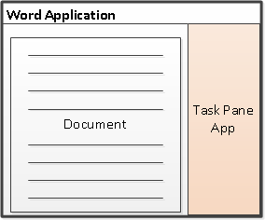
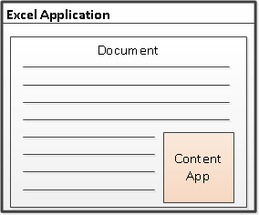
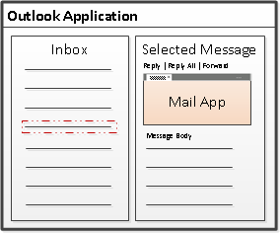
Designing Apps for Office - Shapes
Apps for Office come in three different shapes
Task Pane App
Content App
Mail App
Notes:
When you begin to design an app, you must pick one of the three different shapes.
You can create a document-based app as either a Task Pane App, which is displayed along the right side of the document
OR a Content App, where the app is delivered in a frame inside the document
Alternatively, you can create a Mail App that targets Outlook and Outlook OWA.

Slide 42
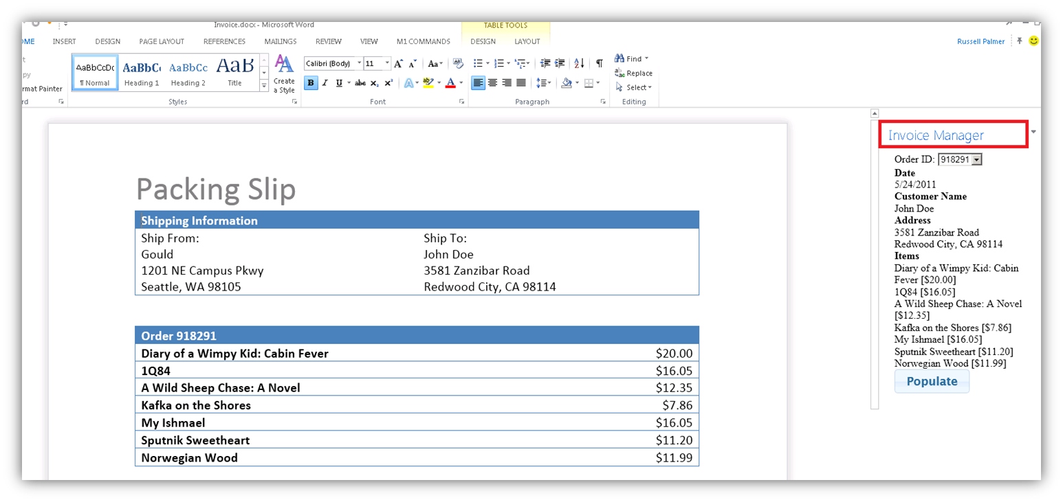
Task Pane App User Experience
Familiar User Experience
Leverages familiar Office UI paradigm
Reference Information
Ideal for providing reference information associated with document.
Notes:
One reason to create a task pane app is that it provides Office users with a familiar user experience. For example Microsoft Word and Microsoft Excel have exposed many of its internal features using task panes so task pane apps provides a familiar Office UX.
A task pane app will initially display about 320px wide to the right of the document, but can be resize, moved, and even undocked from the Office window, the key being task pane apps are NOT part of the document…they support the document.
Task pane apps are ideal for providing users with reference information. For example, a task pane app can perform Internet searches or lockups and provide reference information that can be inserted back into the current document.

Slide 43
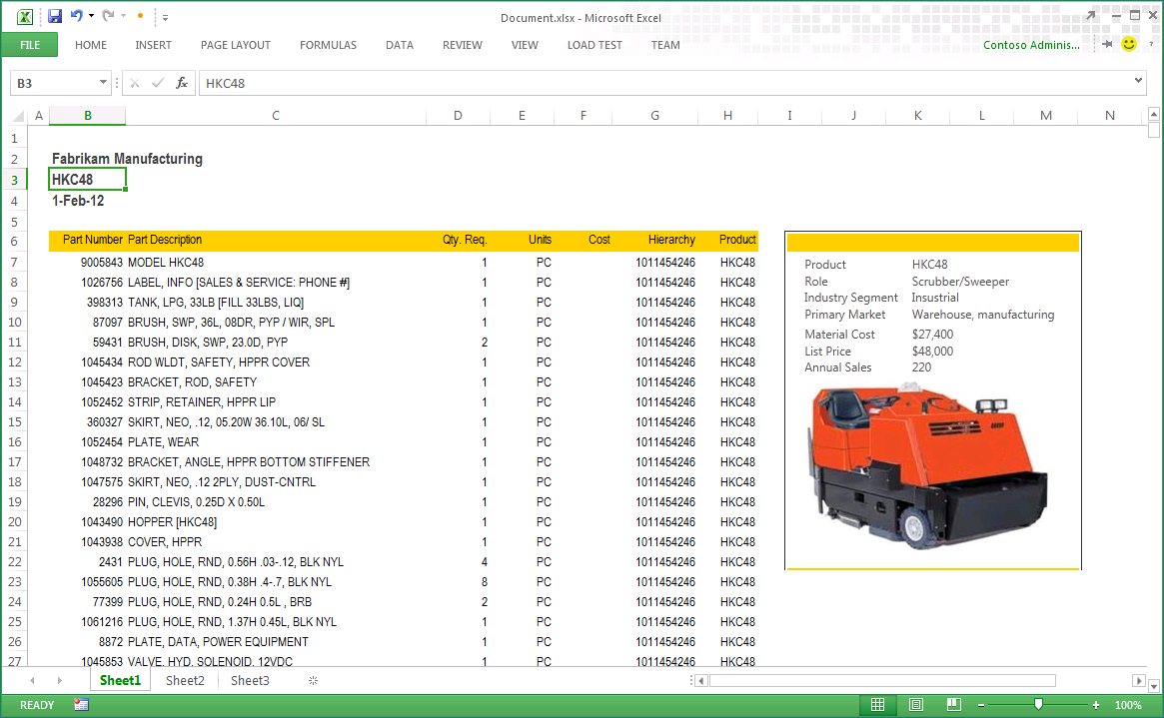
Content App User Experience
Content app is part of document
embedded inline within content
Implemented as Excel shape
User is in complete control.
User may resize, move, copy, paste, print, etc.
App travels with document
Provides simple, yet secure, distribution.
Placeholder image shown if app is not available.
Notes:
A content app is different because it becomes part of document itself, where it is embedded directly inline.
With Excel, the content app is implemented as an Excel shape and the user is in complete control. That means that although content apps can have a default height/width, the user is free to resize a content app or to move it or copy and paste it using the clipboard.
The content app will also print out along with the document itself.
One of the benefits of being embedded in the document is that the app travels with the document, providing a simple, yet secure means of app distribution.
When a user who is offline and the app cannot reach its source location, Excel is still able to display a cached placeholder image from the last save. Basically Excel take a png image of the app when the workbook is saves that is can leverage for this

Slide 44
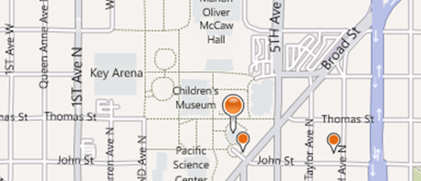
Mail App User Experience
Subtle User Experience
Designed to activate in specific scenarios
Designed to be unobtrusive until used
Provides Supplemental Information
Provides additional information based on rules applied to a messaging item.
Notes:
Mail apps have been designed to create a subtle user experience meaning that they stay out of the way and unobtrusive until they are called into action.
Each mail app is designed to activate based on specific criteria and will be completely invisible until this criteria is met. Even when this criteria met, mail apps only provide a link on the app bar until they are clicked and explicitly started by the user.
When a mail app is started, its purpose it to provides supplemental information to the user about the target item on which it was activated. A mail app often provides additional information based on activate rules applied to a messaging item.
For example, if the activation rule is based on a regular expression which located FedEx shipping numbers, the mail app could lookup the FedEx shipping number on the FedEx Web site and show the user the latest tracking information.
A corporate example might be to activate based on a billing code in the subject or body or based on sender of a message

Slide 45
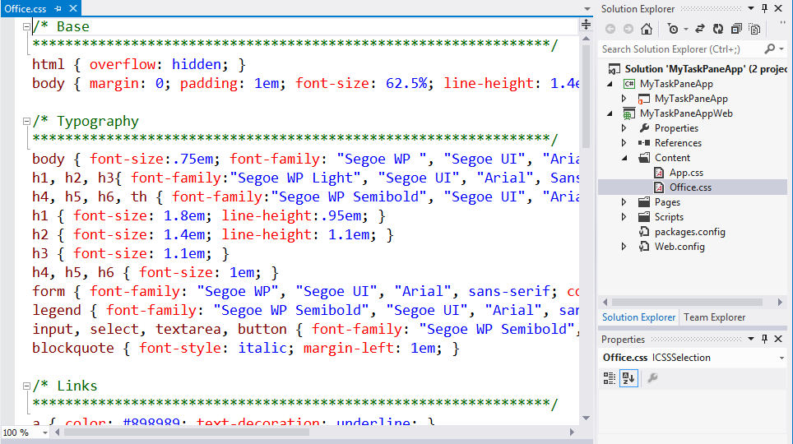
Theming and Branding Apps for Office
Use UI elements consistent with Office
Leverage Office.css file (Office UI CSS) in Visual Studio projects
Use consistent CSS for formatting such as typography
Notes:
When designing apps, be sure to create UI elements that are consistent with the general Office 2013 look and feel.
You are encouraged to leverage the styles that are included with a CSS file named Office.css which has Office 2013 styling built in. This CCS file will be automatically included in App for Office projects created with Visual Studio 2012.
The CCS file provides consistent UI styling things like for typography (i.e. fonts) and scrollbars.
Let’s look at an example of how styling can impact the UX of an App for Office

Slide 46
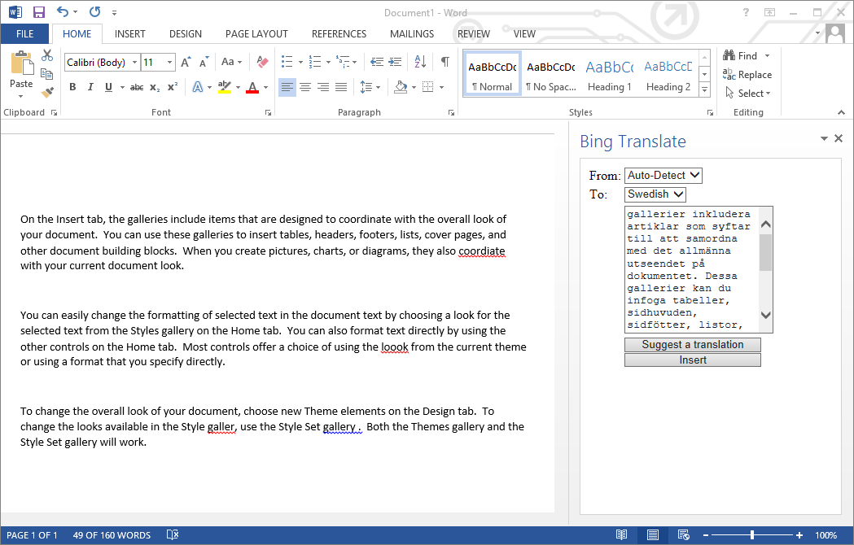
Example App Without Any Theming
Notes:
Here is a simple task pane app without any styling. This obviously doesn’t fit with the general office UI.
Just because the task pane is a window into remote web server does not mean we have to make it look that way.

Slide 47
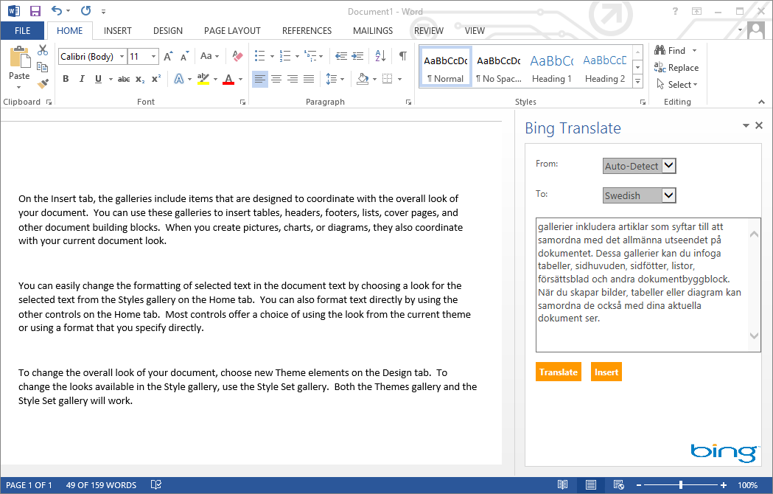
Adding Styles to Theme an App
Notes:
In this screenshot, the app has now incorporated the Office.css file so that its display elements takes on the general look and feel of the Office UI.
In this case, the app has also been given additional styles and a logo to give it its own unique personality.

Slide 48
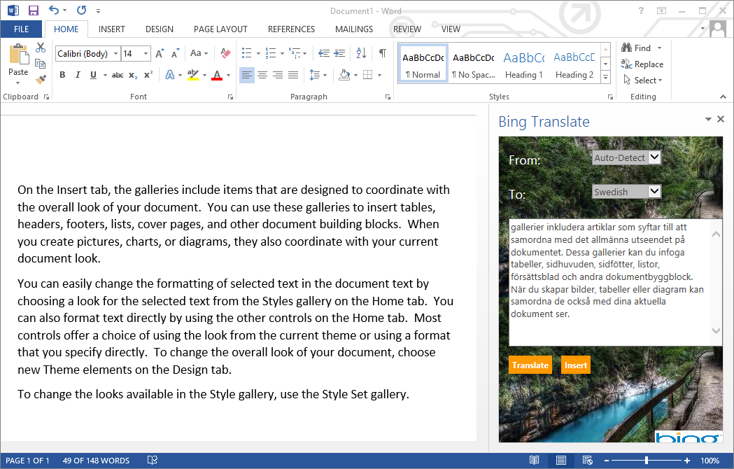
Branding An App
Notes:
Finally in this rendition, the app has been extended with a background image to give it more of a sense of branding.

Slide 49
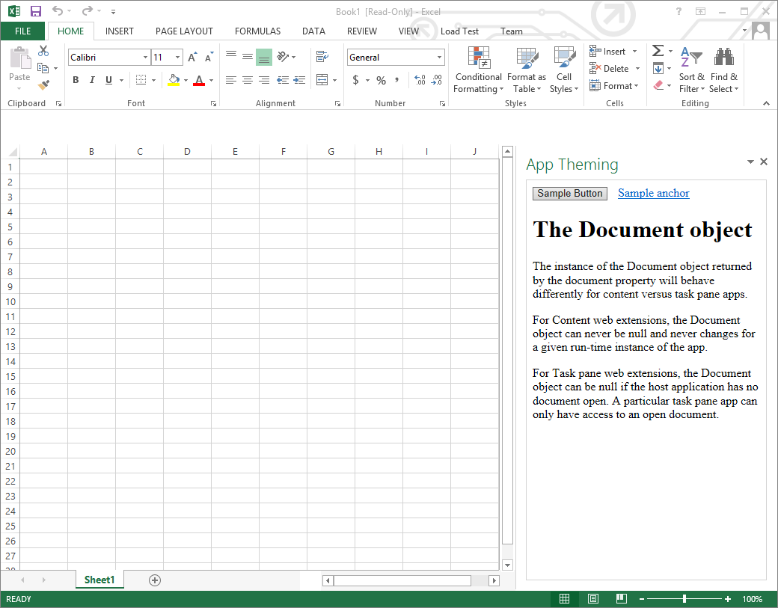
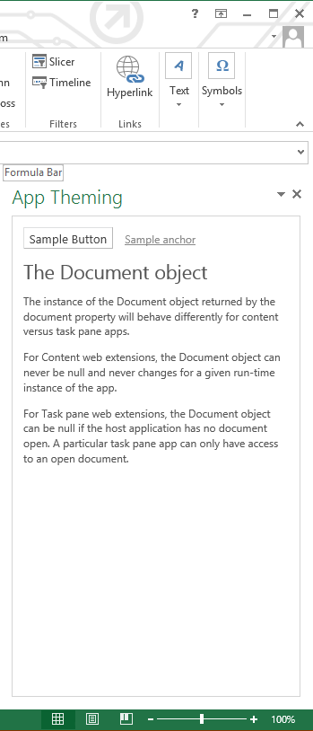
Blending in with CSS
Notes:
Here is another sample where the only change was referencing the Office styles available inside Office.css.
As you can see, by simply linking to this file, an app instantly takes on the font styling and scrollbars of the Office 2013 UI.

Slide 50
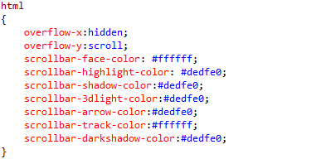
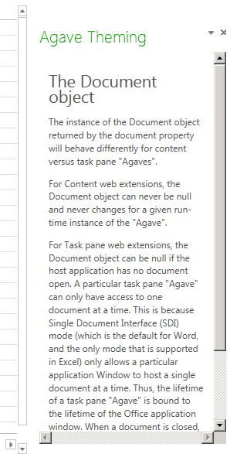
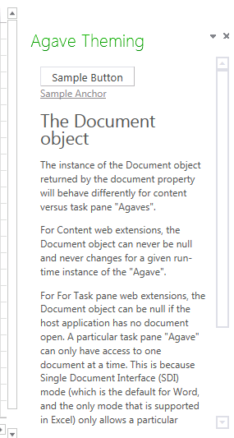
CSS For Scrollbars
Scrollbars
should generally be avoided
vertical scrollbar in Task Pane is OK.
IE Scrollbars vs. Office Scrollbars
Scrollbars in app use IE scrollbars
IE scrollbars look different than Office 2013
Rely on CSS to simulate the Office 2013 look
Default scrollbar
Office style scrollbars.
Notes:
Let’s talk scrollbars
In general…don’t use them! Horizontal scroll bars are never acceptable in an type of App for Office…this makes it important to design around app width. Remember that task pane apps have a default width of 320px while content apps can have a default size specified. However, in but bases the user can resize the app
Again…overflow-x should be hidden
In specific cases where hey are needed, it is acceptable to use vertical scrollbar in task pane apps only. An example might be a Wikipedia lookup on a selected word…this could be lengthy.
In cases where an app uses a scrollbar, make sure it is styled using styles.css. That's because IE and other browsers produce default scrollbars that do not fit in well with the Office UI.

Slide 51
Navigation and Links
DOs
Provide hyperlinks to open in browser
Design app to fit on one host page
Use iFrame with navigation bar if absolutely necessary
Consider ways to provide messages to users
DON’Ts
Expect hyperlinks to open in app window (blocked).
Send users to trapped pages via poor navigation trails
Use alerts
Notes:
This slides discusses what to use and what to avoid when designing an app.
DOs
Do provide hyperlinks within an to open Web pages in a new browser window. This makes it easier to design an app that fits cleanly on a single host page.
Within the host page you can also use an iFrame to host content and provide a navigation bar or tabs if needed to change the contents of the iFrame using JavaScript.
Also consider how your app will provide informational messages to the user. Typically this is done by adding a HTML element such as a div to the host page and dynamically writing text inside using JavaScript.
Consider touch users in your design element decisions (ex: hover flyouts)
DON’Ts
When creating hyperlinks, do not use <a> tags without a target attribute to open the link in a new window browser. You will find that such links are blocked by the Office UI if they attempt to take the user to a different domain.
Also avoid links which navigate the user to pages which do not allow them to return to the start page as there is nothing similar to the back button inside the browser.
Also, avoid interaction with the user using the JavaScript alert function which has more restrictions inside an app than it does when used inside a browser.

Slide 52
Context Menus and Settings Controls
Full control of what is inside the App for Office
Developer can override the right-click Context Menu
No Control to customize the App container menus.
Developer cannot customize Task Pane or Content/Chart object menu
Ability to save settings to “property bag”
Property bag values saved with the app in the document
With Mail Apps for Office property bag values save within Exchange
Notes:
If you want an app to provide custom menus to the user, you should understand that you have control only of the users interface inside the app but not any UI elements outside.
You can override the app context menu that appears at the upper right-hand corner of an app. However, when creating an app you have no control over customizing any other menus within Office apps.
Also remember that you have the ability to save custom properties as name values pairs using the settings API. These names value pairs are saved within the current document with task pane apps and with content apps.
With mail apps these property values are saved within Exchange along with the host message or appointment.

Slide 53
Summary
Introduction to Apps for Office
Developing Apps for Office with Visual Studio 2012
Packaging and Deploying Apps for Office
Designing and Theming Apps for Office

Slide 54
Q&A

Slide 55

© 2012 Microsoft Corporation. All rights reserved. Microsoft, Windows, Windows Vista and other product names are or may be registered trademarks and/or trademarks in the U.S. and/or other countries.
The information herein is for informational purposes only and represents the current view of Microsoft Corporation as of the date of this presentation. Because Microsoft must respond to changing market conditions, it should not be interpreted to be a commitment on the part of Microsoft, and Microsoft cannot guarantee the accuracy of any information provided after the date of this presentation. MICROSOFT MAKES NO WARRANTIES, EXPRESS, IMPLIED OR STATUTORY, AS TO THE INFORMATION IN THIS PRESENTATION.

